Slide 1
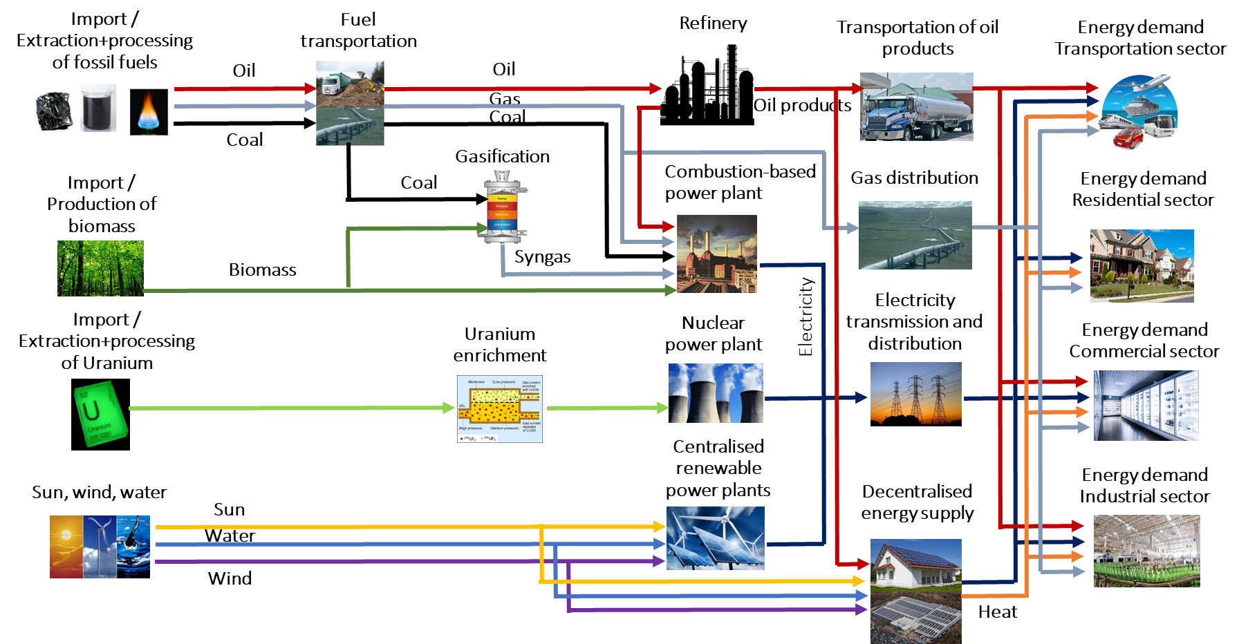
From reality to a model
The complexity of the energy system can be simplified and represented in an organised model structure.
Resources
Primary
Secondary
Final

Slide 2
Reference Energy System (RES)
The above may be called a Reference Energy System (RES)
RES is a simplified and aggregated graphical representation of the real energy system under analysis;
RES covers not just the present configuration of the energy system, but also possible development paths;
It shows all existing and potential new energy supply chains, from primary energy resources to final demand;
The level of simplification depends on issues to be analysed and data availability;
RES should be a minimum representation of reality needed to answer the policy questions;

Slide 3
Reference Energy System (RES)
RES consists of:
Energy Levels
Resources, Primary, Secondary,..., Final,…
(extracted from resources, processed, converted, transmitted, distributed, …)
Energy carriers / commodities
Coal, oil, gas, wood, nuclear fuel, electricity, heat,…
Technologies
Which extract, process, convert energy from one to another form or to energy service, transmit and distribute
Notes:
Can we make this slide more interactive..

